Slide 1
Final Project-Part1
Accelerate Convolution Neural Network with CUDA
NCTU 2017 Fall Computer Architecture
TA： Jyun-Wei Pan
Email：s0550233.ee05g@g2.nctu.edu.tw
Lab： Parallel Computing System - ED520

Slide 2

You will learning…
Hardware Knowledgement
NVIDIA GPU
Parallel Programming
CUDA programming
CUDA optimizations
Deep Learning
Convolution
Relu
Max-pooling

Slide 3
Outline
Introduction to Convolution Neural Network(CNN)
Introduction to GPU Architecture
Introduction to CUDA Code
NVIDIA Visual Profiler
CUDA Example
Assignment
Grading Policy
Reference

Slide 4
Outline
Introduction to Convolution Neural Network(CNN)
Introduction to GPU Architecture
Introduction to CUDA Code
NVIDIA Visual Profiler
CUDA Example
Assignment
Grading Policy
Reference

Slide 5
Whether a picture is of an X or an O
?
=

Slide 6
Computers are literal
=
x

Slide 7
Trickier cases
CNN
X
translation
scaling
rotation
weight
CNN
O

Slide 8
Extract some features from the image
=
=
=

Slide 9
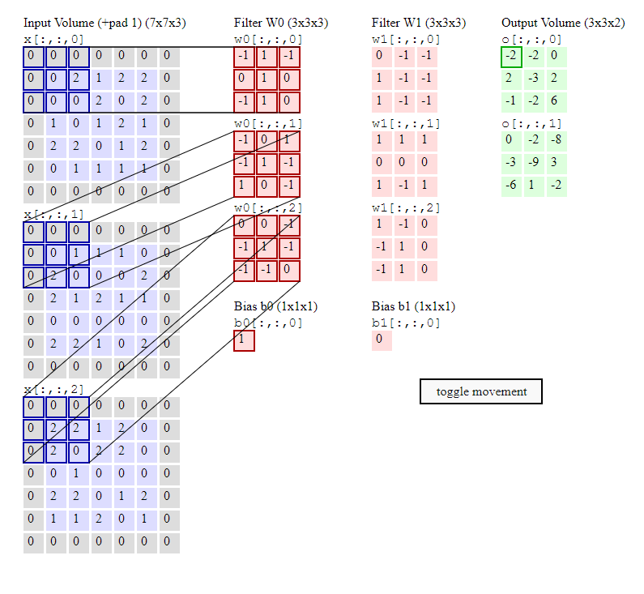
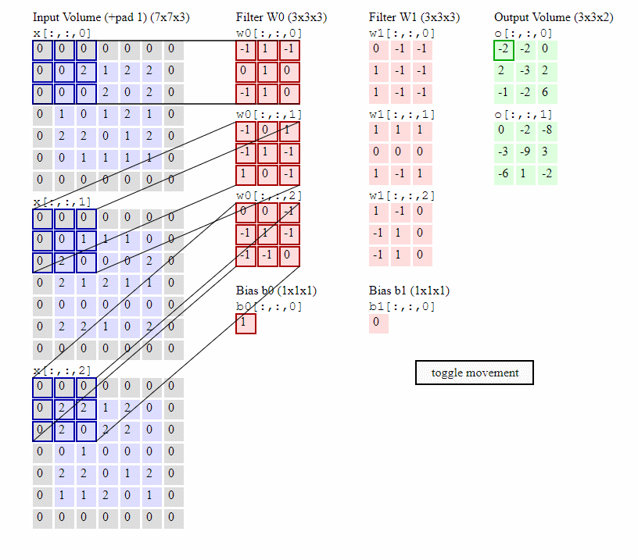
Convolution

Slide 10
Rectified Linear Units (ReLU)

Slide 11
Max-Pooling
maximum

Slide 12
Max-Pooling
maximum

Slide 13
Max-Pooling
max pooling

Slide 14
Outline
Introduction to Convolution Neural Network(CNN)
Introduction to GPU Architecture
Introduction to CUDA Code
NVIDIA Visual Profiler
CUDA Example
Assignment
Grading Policy
Reference

Slide 15
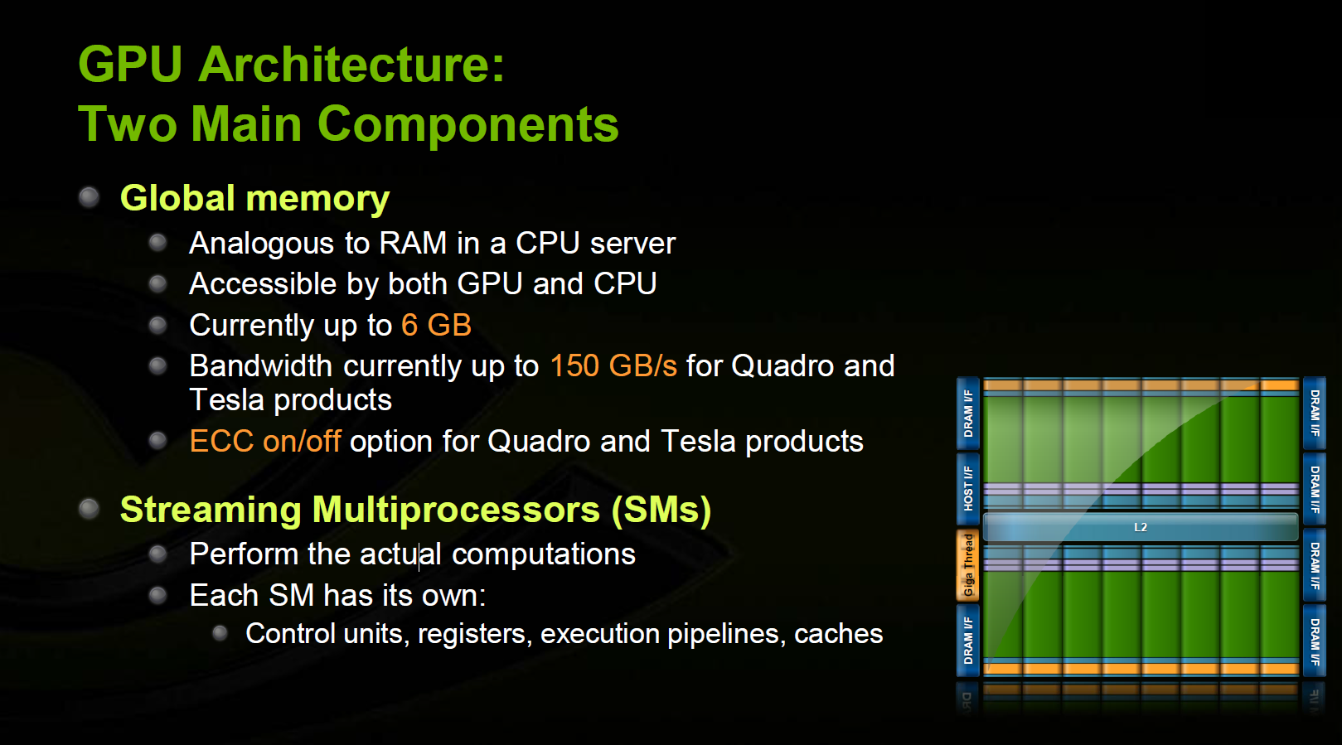

Slide 16
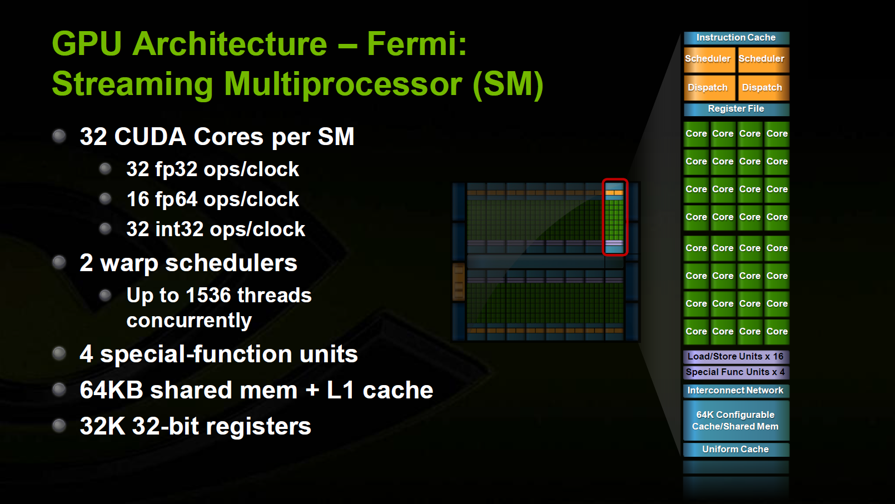

Slide 17
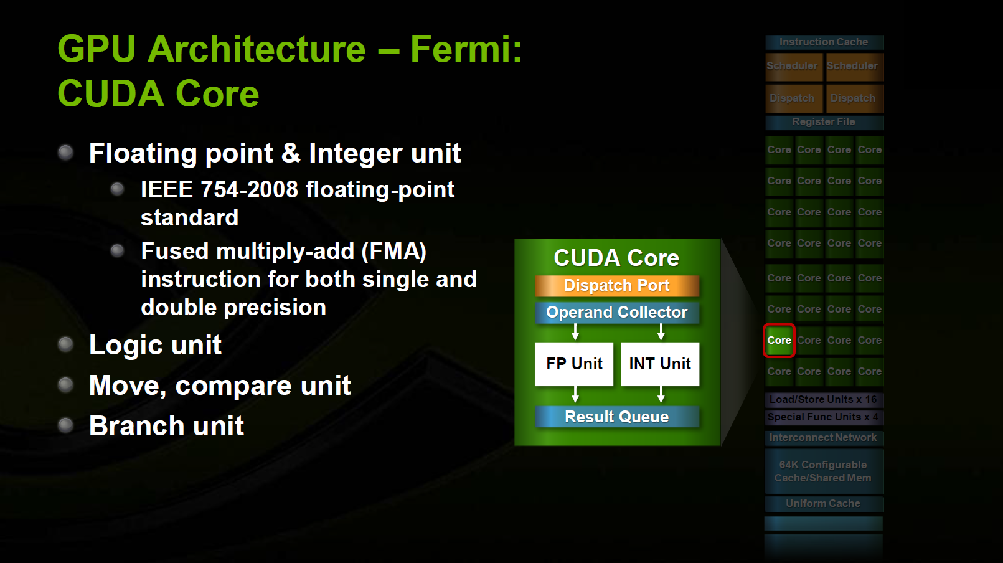

Slide 18
Outline
Introduction to Convolution Neural Network(CNN)
Introduction to GPU Architecture
Introduction to CUDA Code
NVIDIA Visual Profiler
CUDA Example
Assignment
Grading Policy
Reference

Slide 19
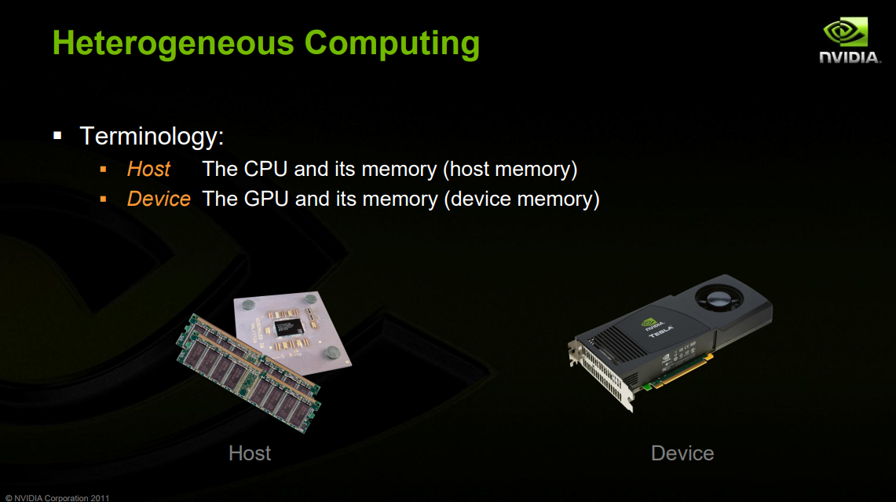

Slide 20
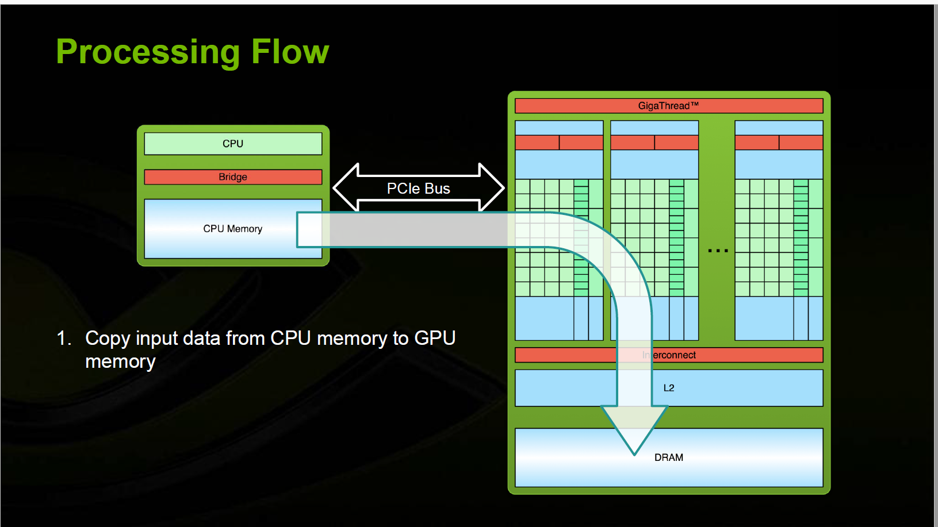

Slide 21
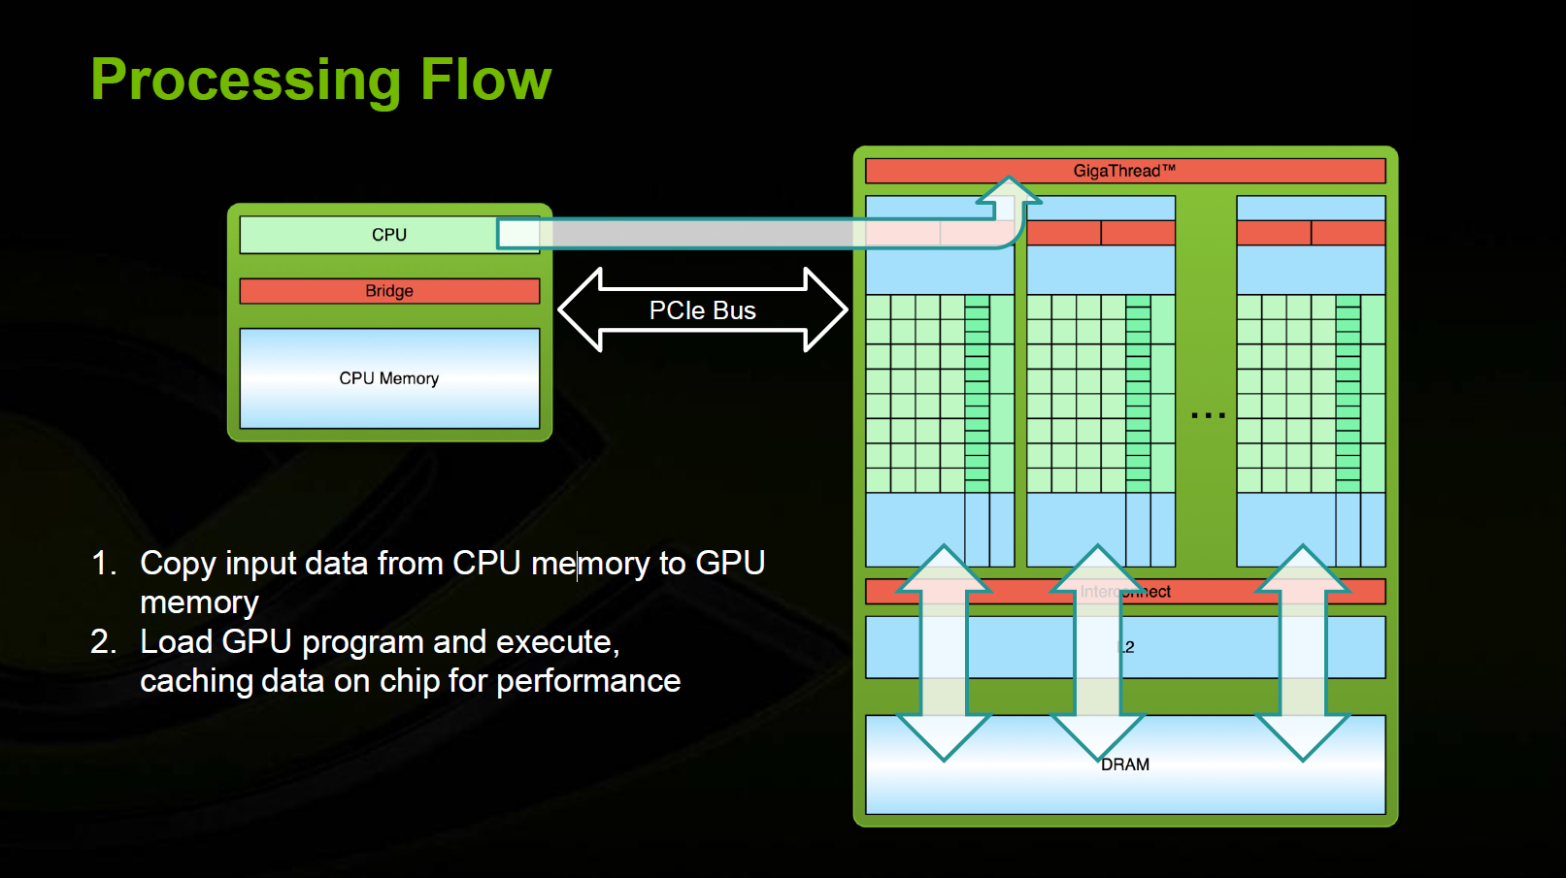

Slide 22
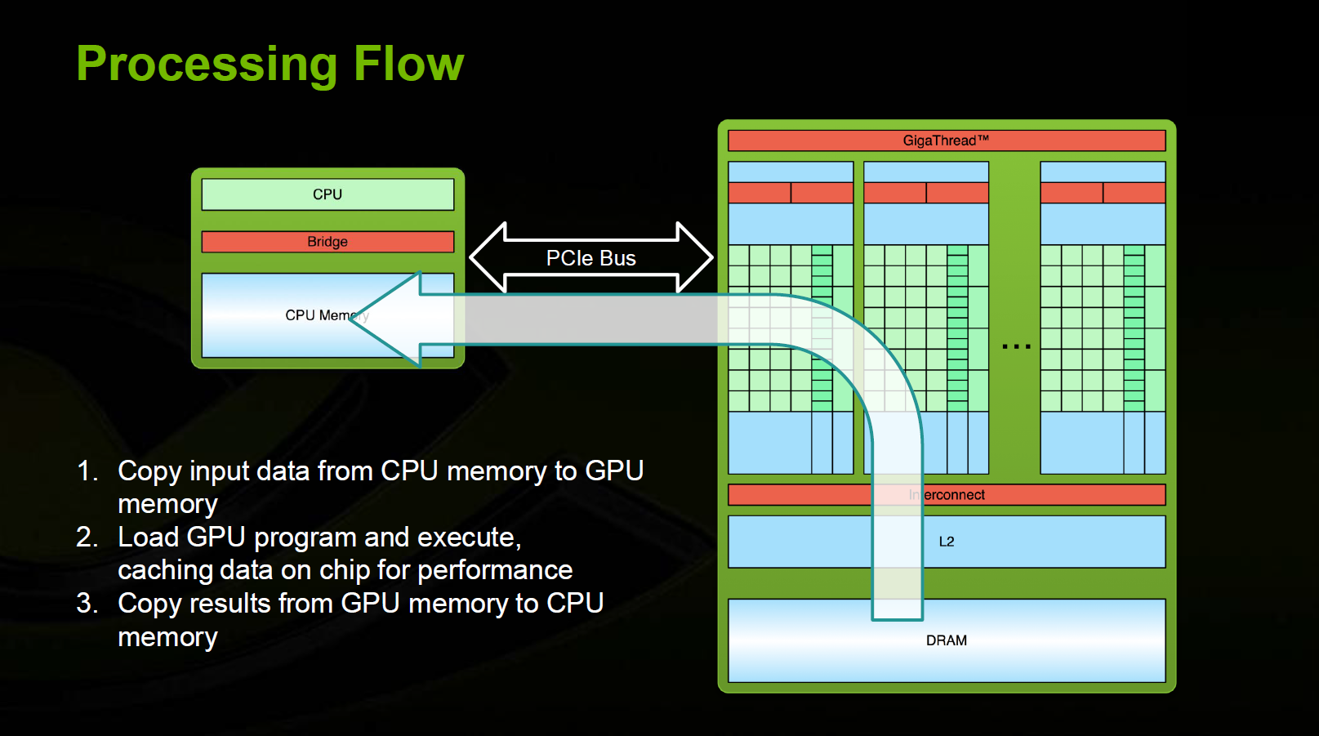

Slide 23
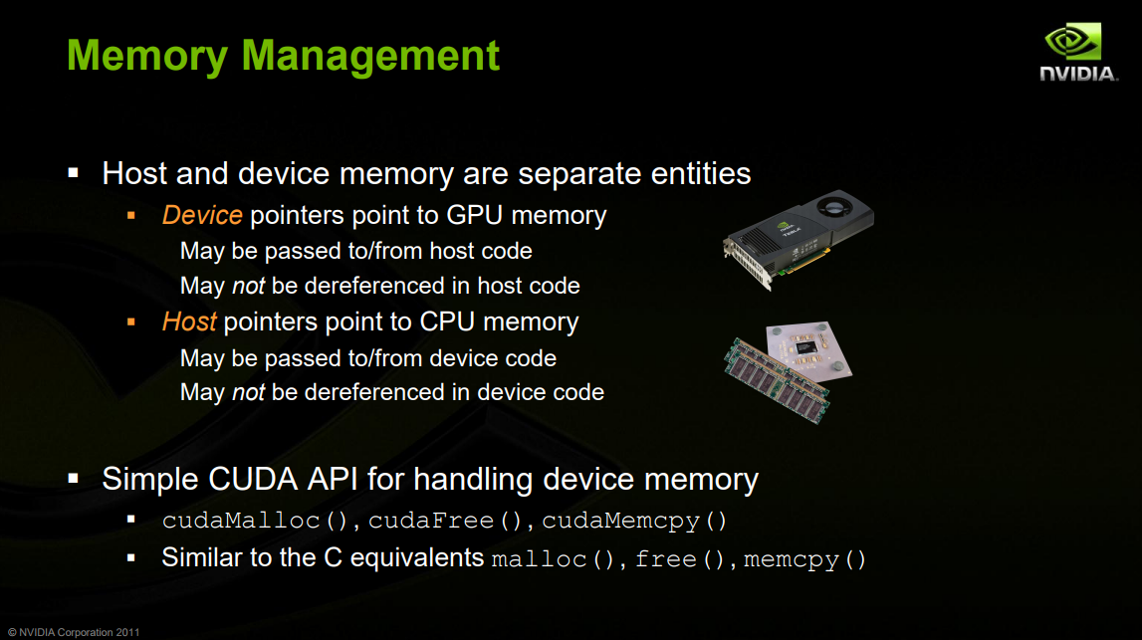

Slide 24
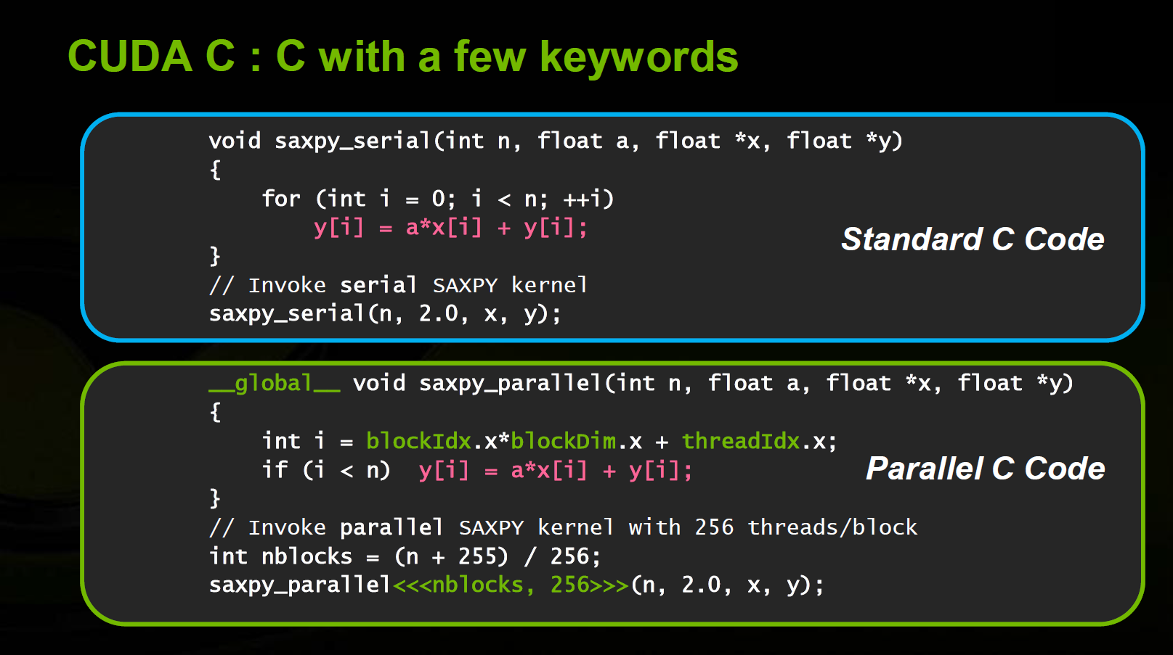

Slide 25
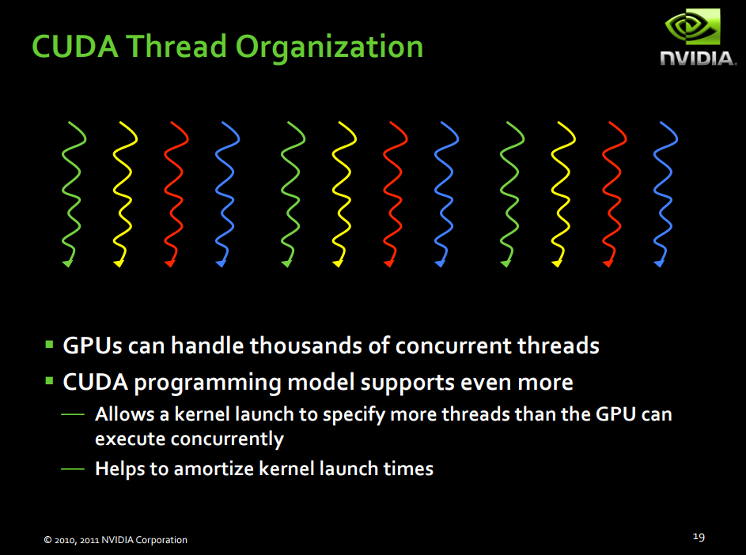

Slide 26
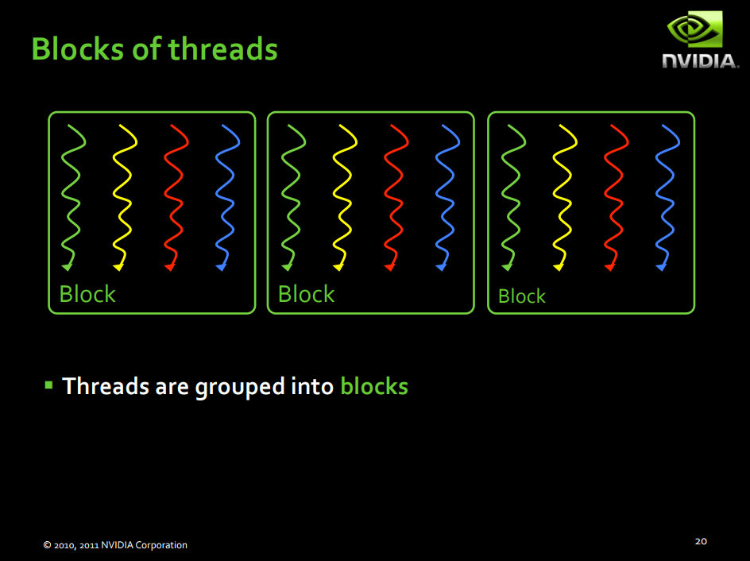

Slide 27
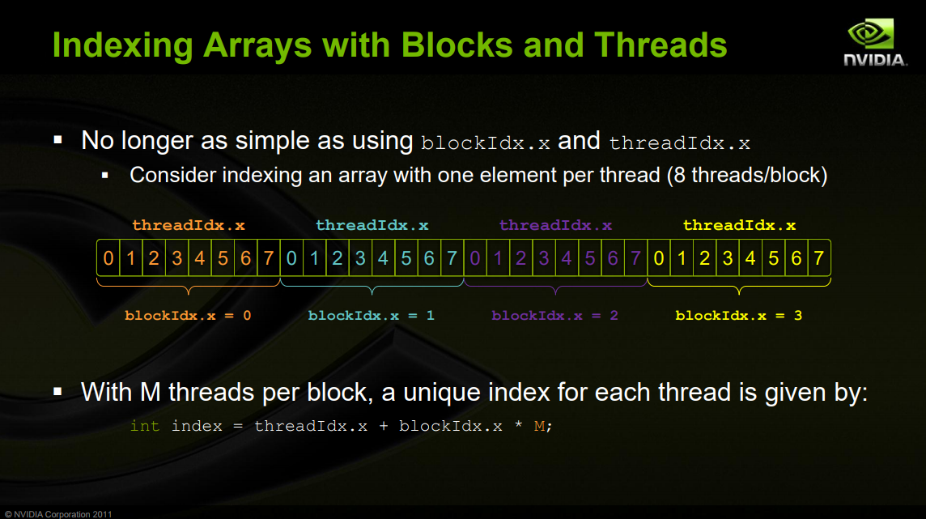

Slide 28
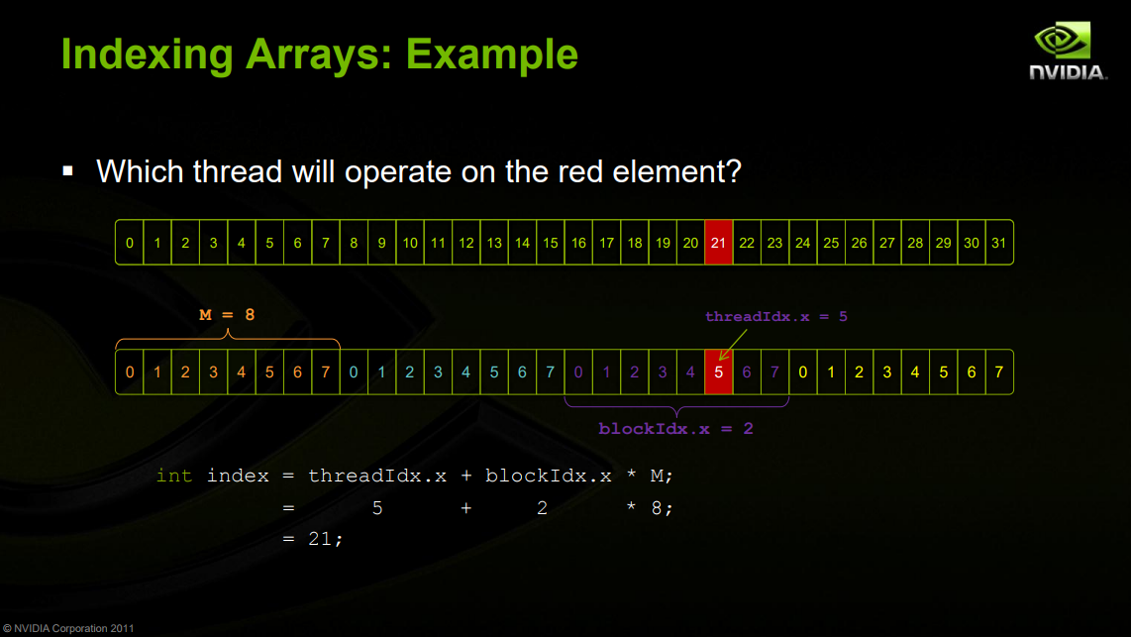

Slide 29
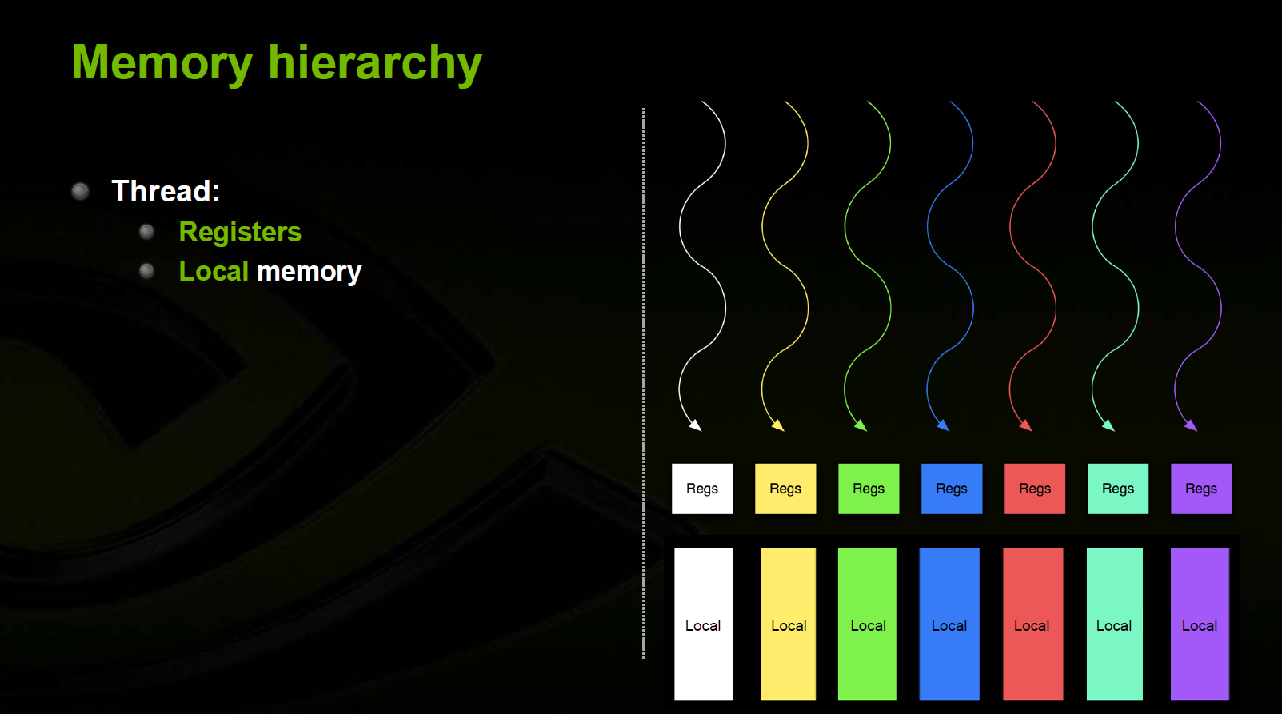

Slide 30
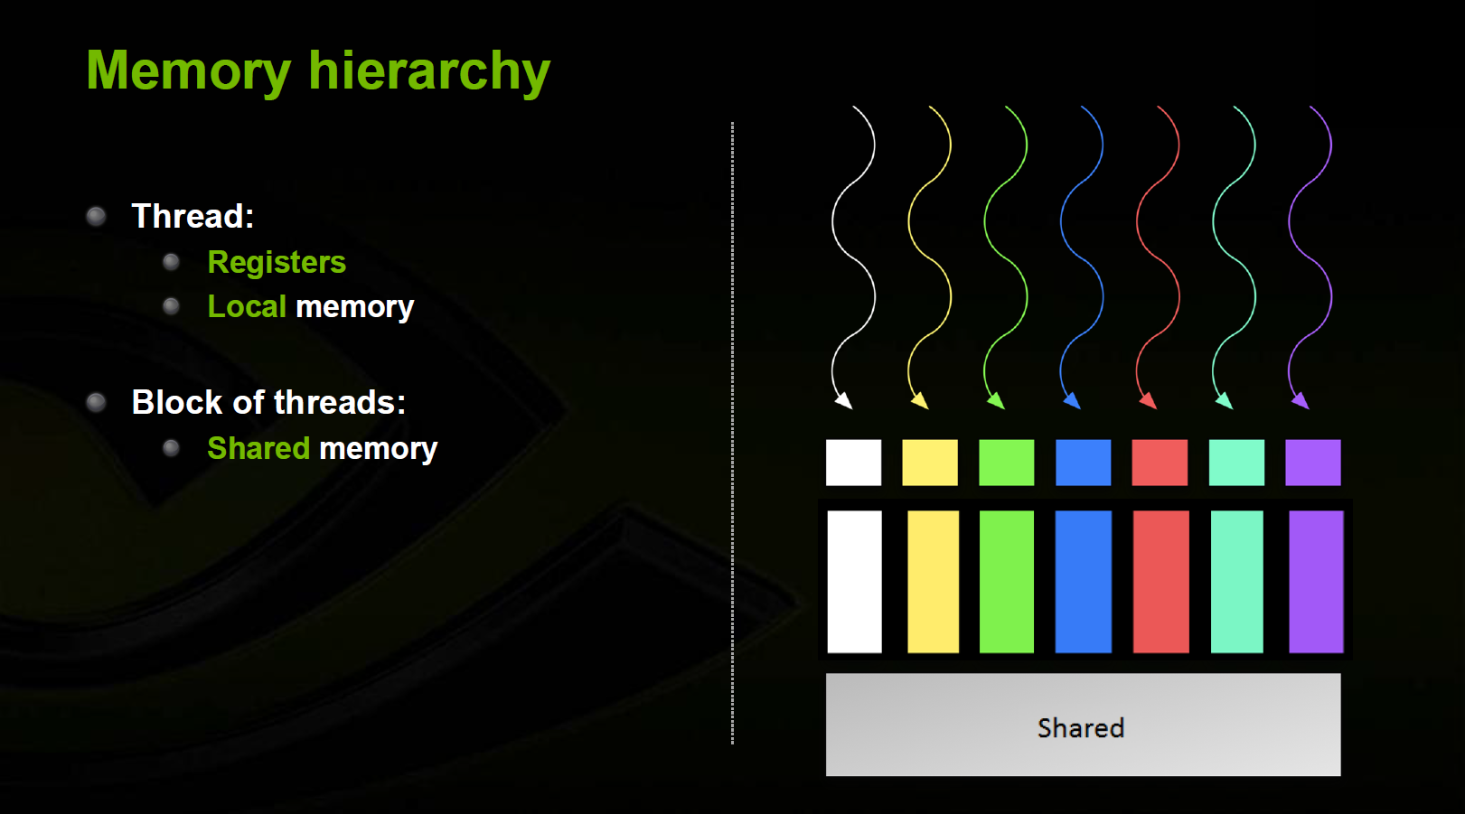

Slide 31
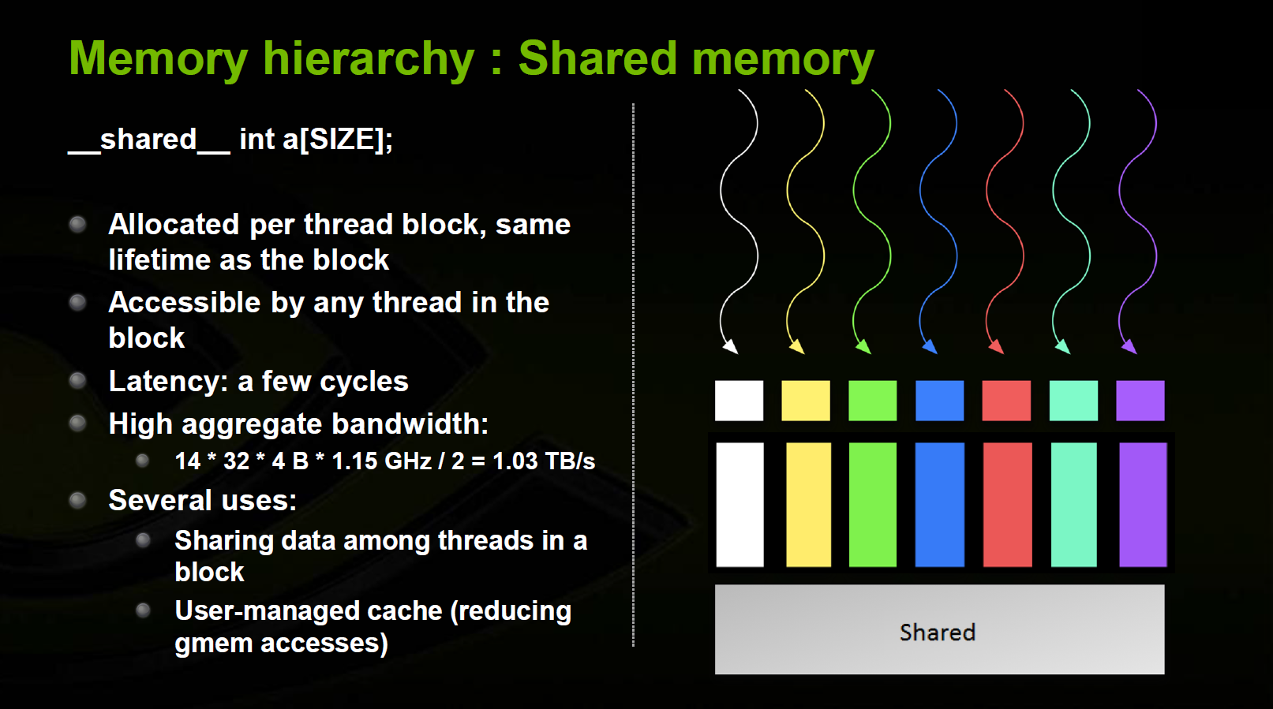

Slide 32
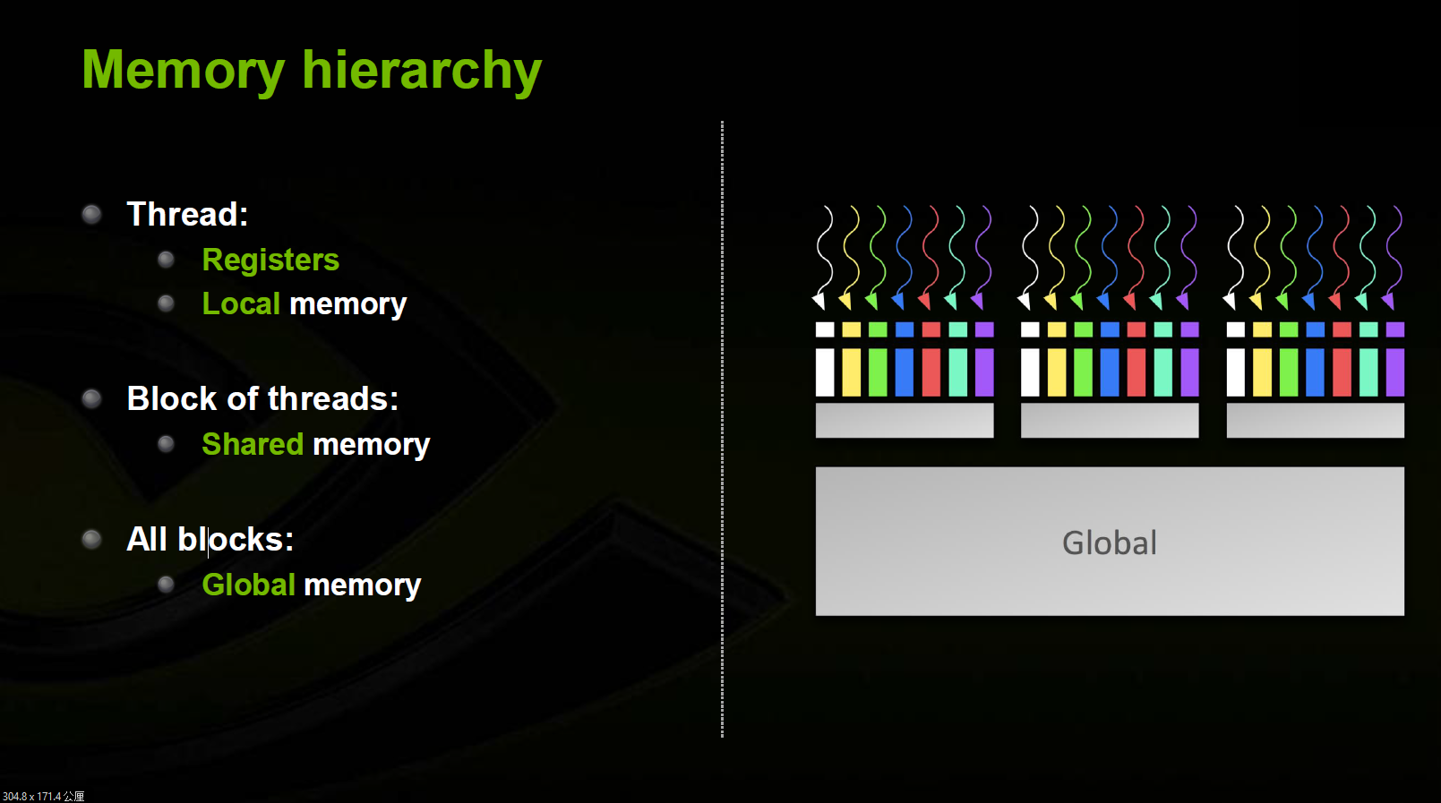

Slide 33
Outline
Introduction to Convolution Neural Network(CNN)
Introduction to GPU Architecture
Introduction to CUDA Code
NVIDIA Visual Profiler
CUDA Example
Assignment
Grading Policy
Reference

Slide 34
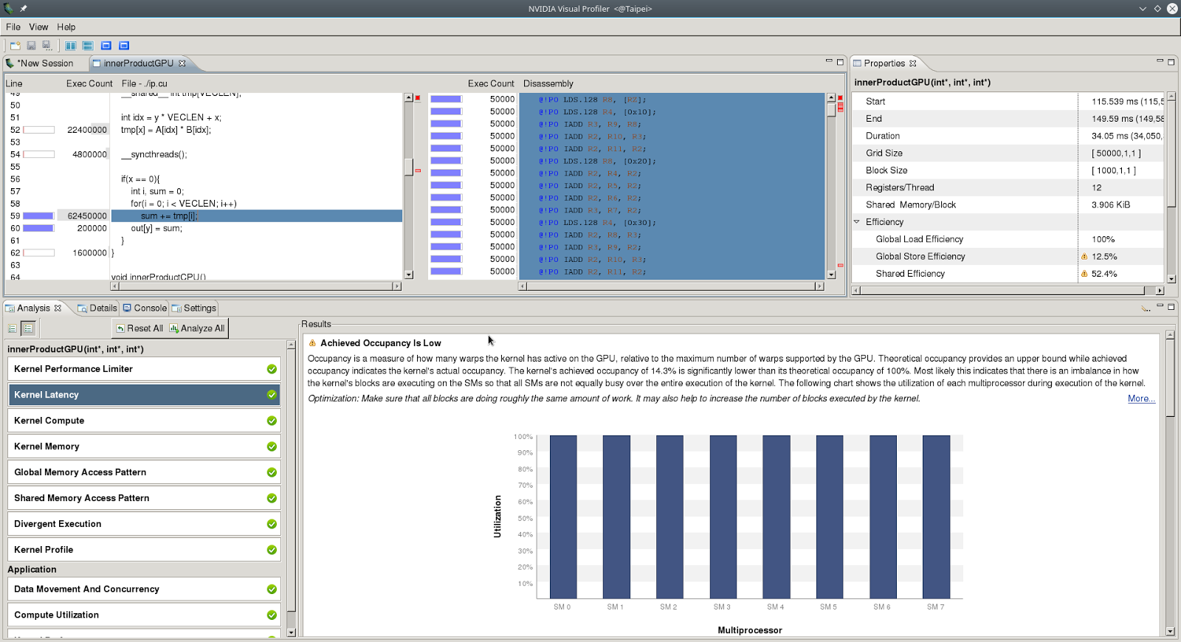
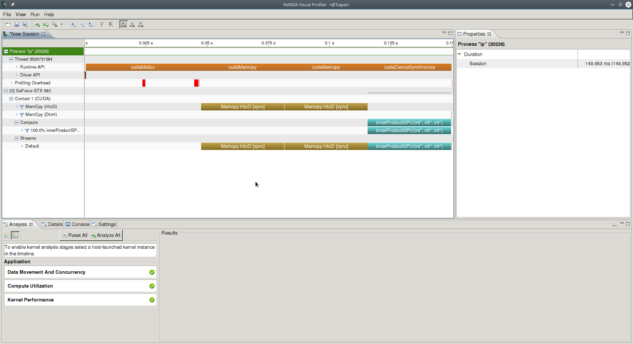
NVIDIA Visual Profiler (NVVP)
It’s a profiling tool to help you to improve you CUDA code.
It provides timing diagram, many analyses and lots of metrics.
How to use：CA70 $ nvvp

Slide 35
Outline
Introduction to Convolution Neural Network(CNN)
Introduction to GPU Architecture
Introduction to CUDA Code
NVIDIA Visual Profiler
CUDA Example
Assignment
Grading Policy
Reference

Slide 36
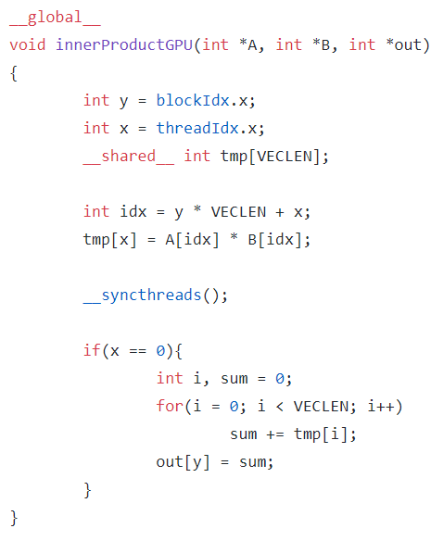
InnerProduct
blockIdx.x
blockIdx.x
threadIdx.x
threadIdx.x

Slide 37
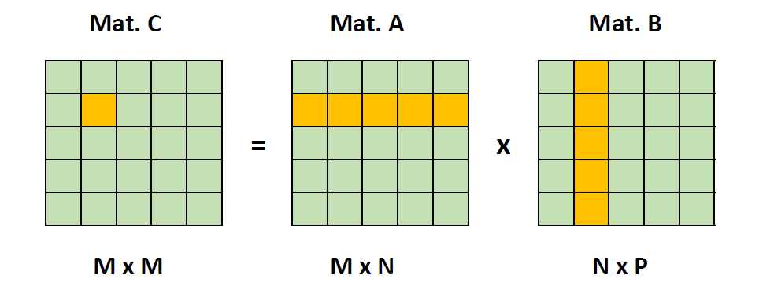
Matrix Multplication
CPU
GPU using tiling
GPU using tiling and shared memory

Slide 38
Outline
Introduction to Convolution Neural Network(CNN)
Introduction to GPU Architecture
Introduction to CUDA Code
NVIDIA Visual Profiler
CUDA Example
Assignment
Grading Policy
Reference

Slide 39
Assignment
Task：Implement convolution , relu , and maxpooling in convLayerGPU() with CUDA
and store your result in the outGPU and use NVVP to analyze your code.
Base Program：
Three sub-directories under the source directory
./device contains a program that can show you device information.
./example contains the CUDA Inner Product and Matrix Multiplication examples.
./data contains the input data for the base program.
Two major files for base program
CNNConvLayer.cu and CNNConvLayer.h
Usage
Compile the code：“make”
Run the code：“make run”

Slide 40
Two input data files (Please do not modify the input data)
./data/filt.txt storing filters’ values
./data/neuron.txt storing input feature maps’ values
init() will read the input data to filt and inNeu
convLayerCPU() will do the same computation with C++ and store the output in the outCPU.
checker() will check whether the values stored in outCPU and outGPU are the same.
clock_gettime() is used to measure your performance
Lunch your CUDA kernel within two clock_gettime() functions
Put cudaDeviceSynchronize() before the last clock_gettime()
You must pass the checking to ensure your result is correct!
We will compare the execution time to get the speedup
Speedup = convLayerCPU_execTime / convLayerGPU_execTime

Slide 41
Other Rules
1. It’s team work, 1 ~ 3 people in one team
- Register here before deadline
2. Compress your code and report into one zip file and upload to E3.
3. Name your report as：LeaderID_Report_FP1.pdf
4. Name your package as： LeaderID_FP1.zip
5. One team only need to upload one package to E3.
6. Make sure TA can compile and run your code with “make” and “make run” on the
provided server
7. Any CUDA library is forbidden to use in this project !!!
8. DELAY IS NOT ACCEPTABLE !!!

Slide 42
Environment
Get base program source code with below command：
$ git clone https://github.com/s0606757/CA2017FP-Part1.git
We provide you a linux server with NVIDIA GPU K20：
IP: 140.113.225.118 SSH Port: 22
Account：ca01~58 (Account List)
Password：nctuca2017
Remember to enable X11 forwarding when you connect to the server for using the
NVIDIA Visual Profiler.
Your code will be evaluated on this server.
Please change your password before 10/12(四)17:00.Otherwise TA will block your account.
Due day：2017/10/26(Thr) 23:50

Slide 43
Outline
Introduction to Convolution Neural Network(CNN)
Introduction to GPU Architecture
Introduction to CUDA Code
NVIDIA Visual Profiler
CUDA Example
Assignment
Grading Policy
Reference

Slide 44
Grading Policy
(A) Completeness (35%)
Your result(convLayerGPU) must be correct (Pass the check) (10%)
Your design(convLayerGPU) is faster than convLayerCPU() (20%)
Use NVIDIA Visual Profiler to help you improve performance(TA will check it in your report) (5%)
(B) Report (35%)
Describe your implementation algorithm and explain your results (15%)
Discuss what kind of optimization you did( it is better or worse?) (10%)
Show how you use NVVP to help you find and solve perf. issues (5%)
Feedback of this part (5%)
(C) Performance Rank (30%)
We will rank your CUDA kernels’ performance(execution time) on GTX K20C
The fastest one will get 30% and the last one will get 1%

Slide 45
Outline
Introduction to Convolution Neural Network(CNN)
Introduction to GPU Architecture
Introduction to CUDA Code
NVIDIA Visual Profiler
CUDA Example
Assignment
Grading Policy
Reference

Slide 46
Reference
Introduction to CNN -1
Introduction to CNN -2
Introduction to CUDA
NVVP
GPU Profiling

